Slide 1


Headline Verdana 48
Subtitle Verdana 20

Slide 2
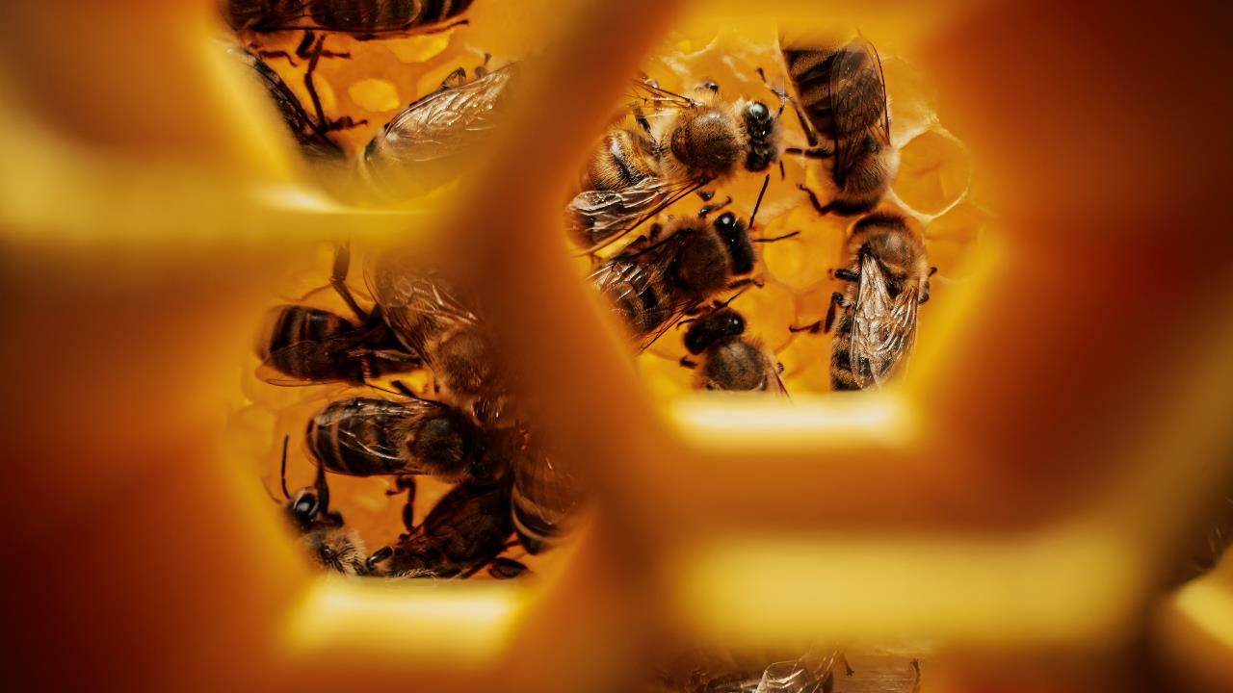
Headline Verdana 48
Subtitle Verdana 20, can also be in two lines, but not more

Slide 3

Title Verdana 48 in two lines, no more
Subtitle Verdana 20, in this version only in one line

Slide 4


Heading Verdana 28. Presentation Objectives
1
Verdana 20 First Objective Title
2
The title of the second Objective Verdana 20. Can be one or two lines, but no more
3
Verdana 20 Third Objective Title
4

Slide 5
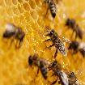


Heading Verdana 28 - Presentation Objectives with Images, Two Lines (No More)
Verdana 20 First Objective Title
The title of the second Objective Verdana 20. Can be one or two lines, but no more
Verdana 20 Third Objective Title
5

Slide 6
Heading Verdana 28.
Main text Verdana 14. Left alignment of characters. Line spacing – multiplier 1.25. Color black. This presentation uses the system font Verdana, which eliminates document compatibility issues and facilitates file exchange.
This page also uses an example of a page design with solid text and no images or infographics. This design is acceptable if you need to indicate some data that should be displayed in full. But remember that such pages are poorly perceived by the audience, since they do not carry any visual load during the report.
It is important to note about the placement of the event logo. It is prohibited to use it on any background, except black.
6

Slide 7
Methods of design
85%
There are many ways to design text blocks to emphasize important information. For example, numbers, icons, graphs, etc.
respondents confirm that when evaluating design and composition, the text being read interferes with concentration
A formatted piece of text written in the middle of a text block.
To make the page look more interesting, use different methods
selection:
numbers
pictograms
Verdana 14. Characters are aligned in the middle. Line spacing is a multiplier of 1.25. (yellow Color)
You can also highlight certain words or short sentences in a text block by placing a box underneath and highlighting them in bold.
graphs
diagrams
drawings
schemes
7

Slide 8
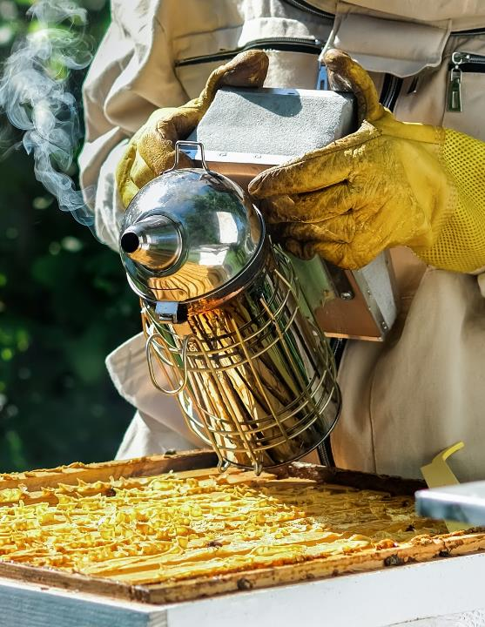
Heading Verdana 28.
Using image
Main text Verdana 14. Left alignment of characters. Line spacing – multiplier 1.25. Color black.
In order for the presentation to look pleasing to the eye, it is better not to use a huge amount of text. If the information does not fit, try to rephrase it in other words so that the message fits. Do not reduce the size of the letters, the line spacing or move the text blocks and images. Orient yourself by the auxiliary lines.
8

Slide 9
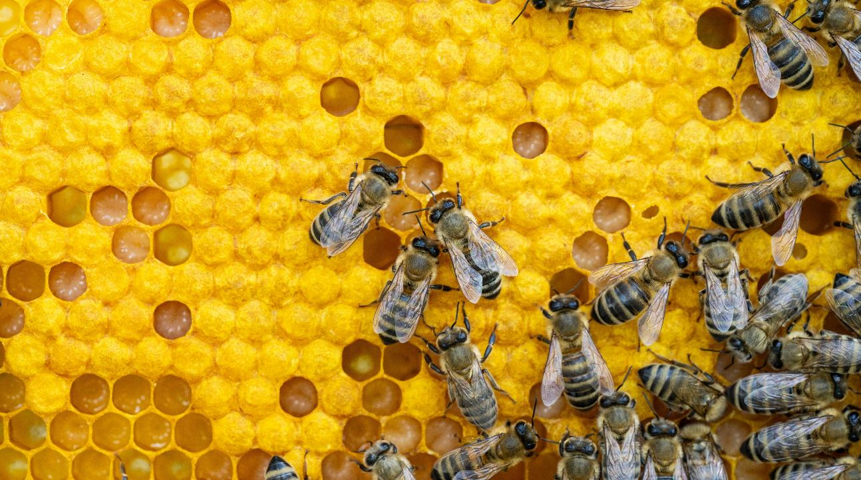

01
Verdana Chapter Separator Header 48
One-line subtitle (Verdana 20).

Slide 10

02
Heading 48
Subtitle, can be 1-2 lines, with a short title (Verdana 20).

Slide 11
03
Headline Verdana 48
The chapter separator subheading, without an image, can be one or two lines (Verdana 20).

Slide 12
Heading Verdana 28. Map of the Russian Federation
The map is editable by double-clicking on it. You can select individual regions and assign fill colors to them.
12

Slide 13
Heading Verdana 28.
World Map
The map is editable by double-clicking on it. Can select individual regions and assign fill colors to them.
13

Slide 14
Heading Verdana 28.
20 000
119%
>25
EMPLOYEES
THOUSAND TONS
The numbers can be designed together with a pictogram, value, name, etc. The name should be as short as possible.
Number (Verdana 60), name (Verdana 20), signature (Verdana 14).
The numbers can be designed together with a pictogram, value, name, etc. The name should be as short as possible.
Number (Verdana 60), name (Verdana 20), signature (Verdana 14).
The numbers can be designed together with a pictogram, value, name, etc. The name should be as short as possible.
Number (Verdana 60), name (Verdana 20), signature (Verdana 14).
14

Slide 15
Heading Verdana 28.
Name of Title
Verdana 20
Name of Title
Verdana 20
Name of Title
Verdana 20
Pictograms are designed together with the title. The title should be as short as possible. Title (Verdana20), ), signature (Verdana 14
Pictograms are designed together with the title. The title should be as short as possible. Title (Verdana 20), signature (Verdana 14).
Pictograms are designed together with the title. The title should be as short as possible. Title (Verdana
20), signature (Verdana 14).
15

Slide 16
Design
Text pads / heading color / background
Lines
Markers on the map
RGB 219 184 96
RGB 245 219 139
RGB 241 228 158
Possible colors for graphs
Diagrams
25%
AUXILIARY
MAIN
16

Slide 17



Pictograms
17

Slide 18



Slide 19
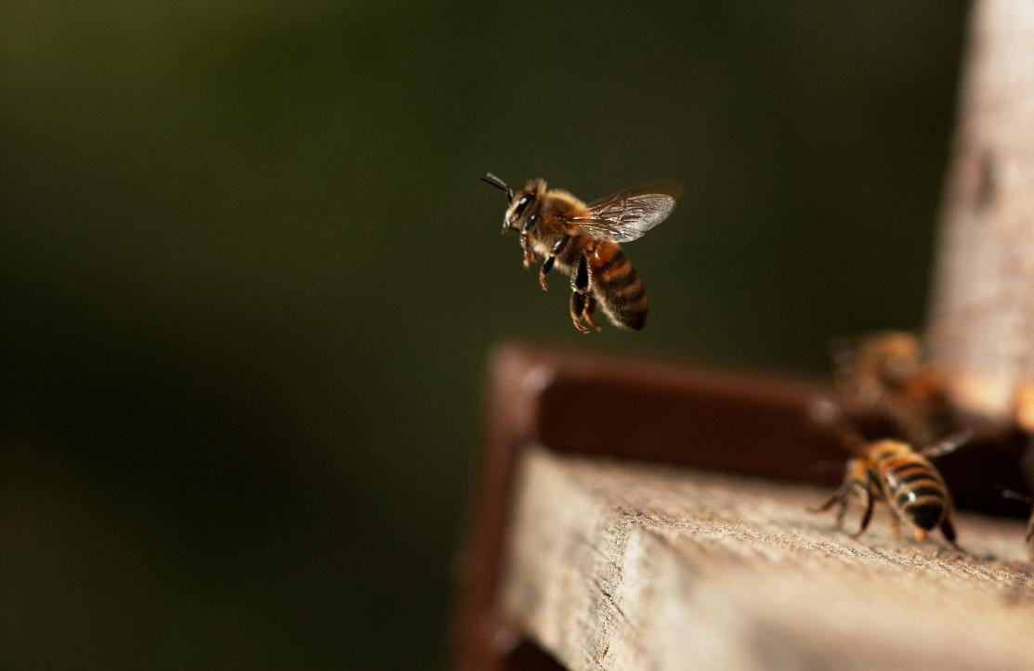

THANK YOU FOR YOUR ATTENTION!

Slide 20

THANK YOU FOR ATTENTION!

